Slide 1
Informed Search – III
Memory-bounded heuristic search

Slide 2
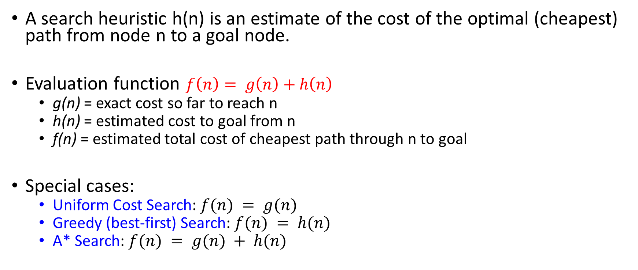
Previous Lecture: Evaluation / Heuristic Function
A search heuristic h(n) is an estimate of the cost of the optimal (cheapest) path from node n to a goal node.
Evaluation function $f\left(n\right)= g\left(n\right)+h\left(n\right)$
g(n) = exact cost so far to reach n
h(n) = estimated cost to goal from n
f(n) = estimated total cost of cheapest path through n to goal
Special cases:
Uniform Cost Search: $f(n) = g(n)$
Greedy (best-first) Search: $f(n) = h(n)$
A* Search: $f(n) = g(n) + h(n)$

Slide 3
Admissible Heuristics
A* search takes into account both
the cost of the path to a node g(n)
the heuristic value of that path h(n).
Let f(n) = g(n) + h(n).
Let c(n) denote the cost of the optimal path from node n to any goal node.
A search heuristic h(n) is called admissible if h(n) ≤ c(n) for all nodes n, i.e. if for all nodes it is an underestimate of the cost to any goal.

Slide 4
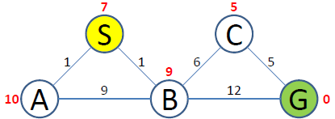
A* Search
Perform the A* Algorithm on the following figure. Explicitly write down the queue at each step.

Slide 5

 | Frontier (f(n)=g(n)+h(n)) | Expand | Explored
1 | (S,0+7=7) | S | Empty
2 | (S-A,1+10=11)(S-B,1+9=10) | B | S
3 | (S-A,11) (S-B-A,{1+9}+10=20) (S-B-C,{1+6}+5=12) (S-B-G,{1+12}+0=13) | A | S,B
4 | (S-A-B,10+9=19) (S-B-A,{1+9}+10=20) (S-B-C,{1+6}+5=12) (S-B-G,{1+12}+0=13) | C | S,B,A
5 | (S-B-A,20) (S-B-C-G,12) (S-B-G,13) | G | S,B,A,C
6 | (S-B-C-G,12) Goal Found |  | S,B,A,C,G

Slide 6
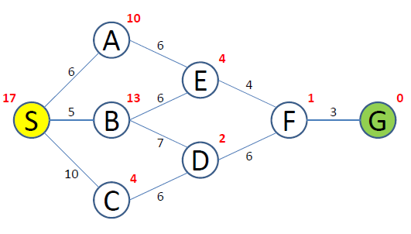
A* Search
Perform the A* Algorithm on the following figure. Explicitly write down the queue at each step.

Slide 7
 | Frontier | Expand | Explored
1 | (S,0+17=17) | S | Empty
2 | (S-A,16)(S-B, 18)(S-C,14) | C | S
3 | (S-A,16)(S-B, 18)(S-C-D,18) | A | S,C
4 | (S-A-E,16)(S-B, 18)(S-C-D,18) | E | S,C,A
5 | (S-A-E-B,31)(S-A-E-F,17)(S-B, 18)(S-C-D,18) | F | S,C,A,E
6 | (S-A-E-B,31)(S-A-E-F-G,19)(S-B, 18)(S-C-D,18) | B | S,C,A,E,F
7 | (S-A-E-F-G,19)(S-B-D,14)(S-C-D,18) | D | S,C,A,E,F,B
8 | (S-A-E-F-G,19)(S-B-D-F,19)(S-C-D,18) | G
9 | (S-A-E-F-G,19) Goal Found

Slide 8
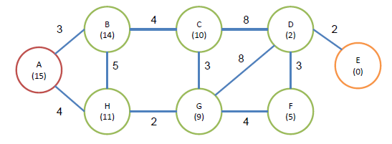
CP
Perform Uniform Cost Search, the Best-First Search, and the A* algorithm. Here we suppose that A is the initial node, and E is the target. The cost of each edge and the heuristic value of the each node are also given in the figure.

Slide 9
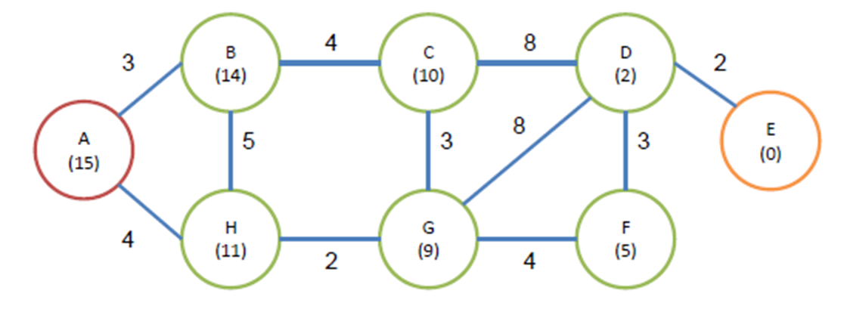
 | Frontier | Expand | Explored
1 | (A,0+15=15) | A | Empty
2 | (A-B,3+14=17)(A-H,4+11=15) | H | A
3 | (A-B,17)(A-H-G,6+9=15) (A-H-B,9+14=23) | G | A,H
4 | (A-B,17)(A-H-G-F,15) (A-H-G-C,19) (A-H-G-D,16) (A-H-B, 23) | F | A,H,G
5 | (A-B,17)(A-H-G-F-D,15) (A-H-G-C,19) (A-H-G-D,16) (A-H-B, 23) | D | A,H,G,F
6 | (A-B,17)(A-H-G-F-D-E,15) (A-H-G-F-D-C,31) (A-H-G-C,19) (A-H-G-D,16) (A-H-B, 23) | E
 | (A-H-G-F-D-E,15) Goal Found

Slide 10
Is A* Optimal?
h = 6
1
A
3
S
h = 7
G
h = 0
5
What went wrong?
Actual bad goal cost < estimated good goal cost
We need estimates to be less than actual costs!

Slide 11
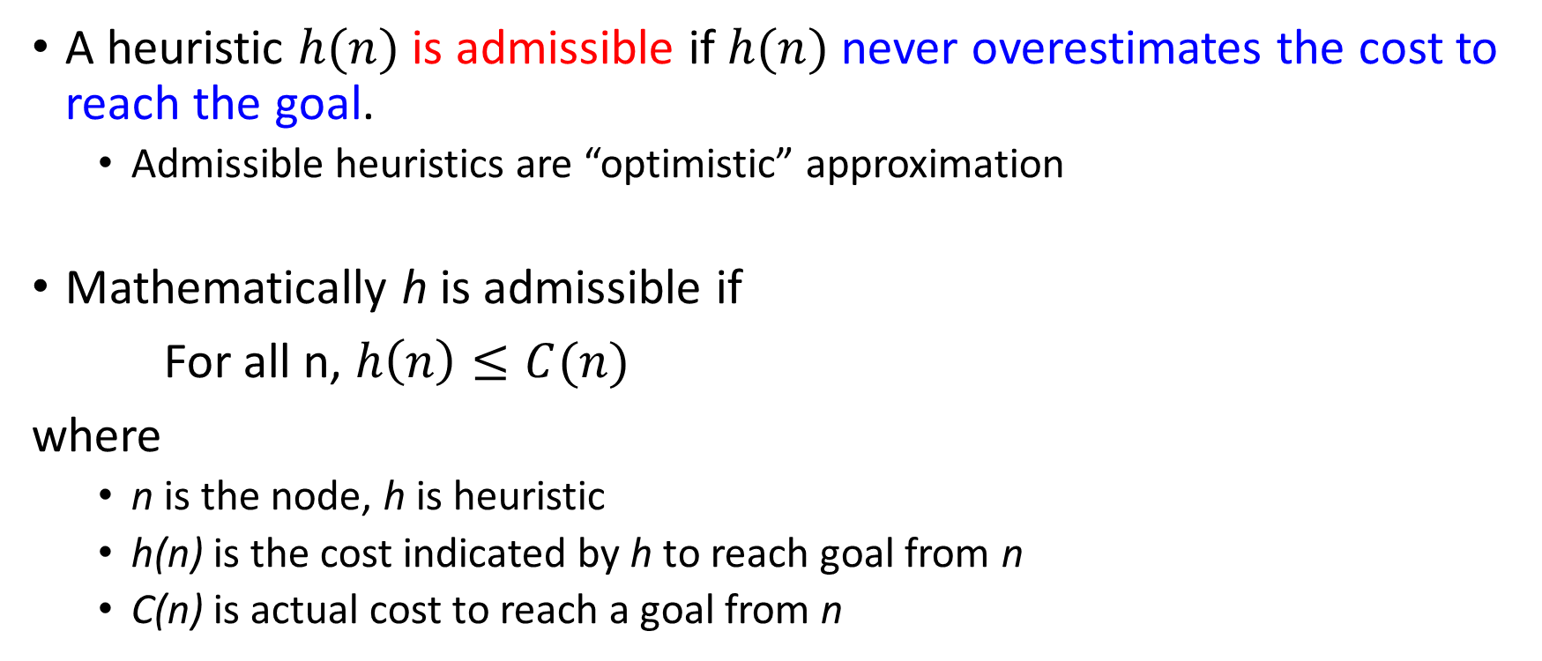
Admissible Heuristic Functions
A heuristic $h(n)$ is admissible if $h(n)$ never overestimates the cost to reach the goal.
Admissible heuristics are “optimistic” approximation
Mathematically h is admissible if
For all n, $h\left(n\right)≤C(n)$
where
n is the node, h is heuristic
h(n) is the cost indicated by h to reach goal from n
C(n) is actual cost to reach a goal from n

Slide 12
Consistency of Heuristics
A
1
Main idea: Estimated heuristic costs ≤ actual costs
Admissibility:
heuristic cost ≤ actual cost to goal
h(A) ≤ actual cost from A to G
Consistency:
“heuristic step cost” ≤ actual cost for each step
h(A) – h(C) ≤ cost(A to C)
triangle inequality
h(A) ≤ cost(A to C) + h(C)
Consequences of consistency:
The f value along a path never decreases
A* graph search is optimal
C
h=4
h=2
h=1
G
But an admissible heuristic is not always consistent

Slide 13
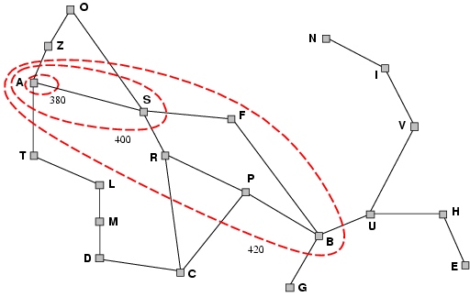
Optimality of A*
A* expands nodes in order of increasing f value Gradually adds "f-contours" of nodes
Contour i has all nodes with f=f_{i}, where f_{i} < f_{i+1}

Slide 14
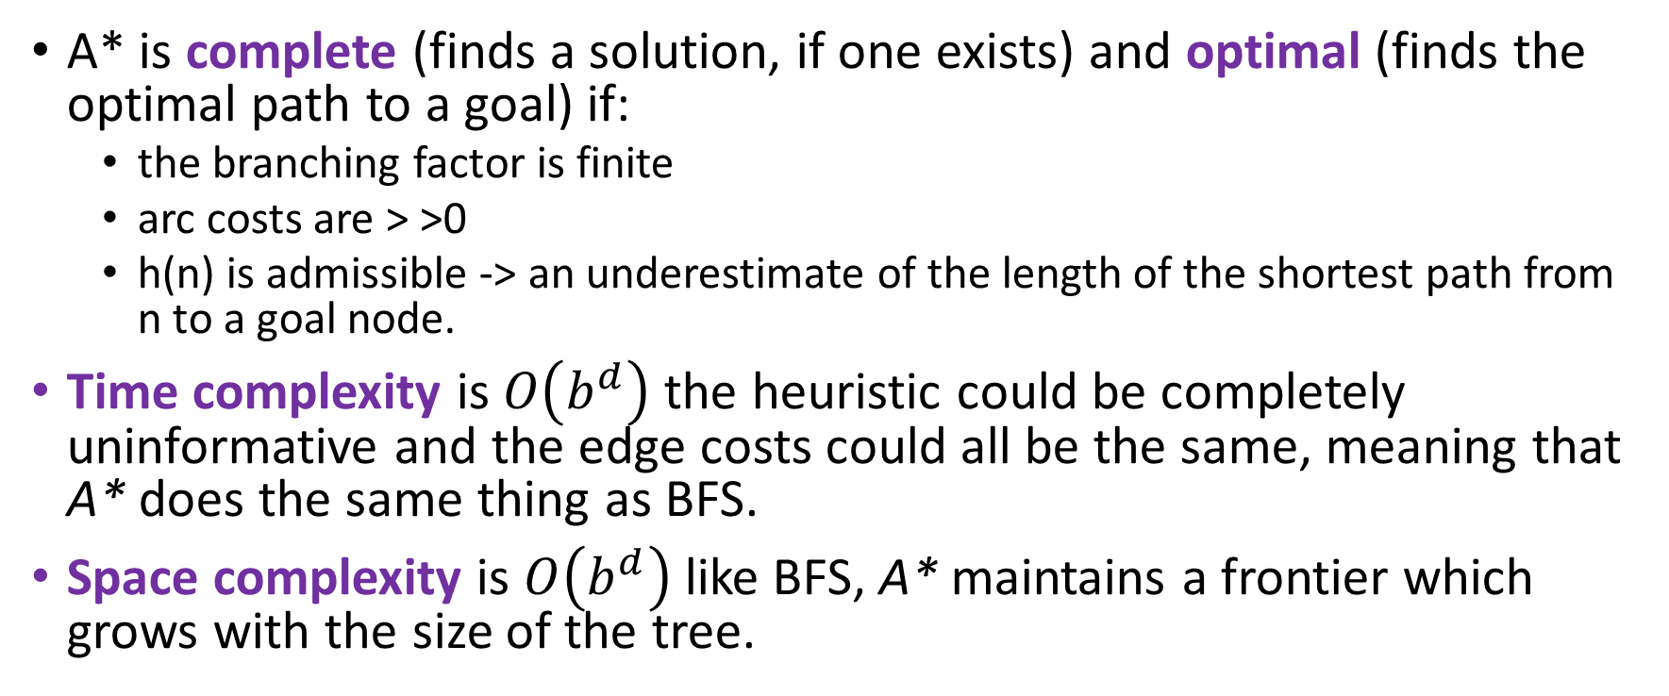
Properties of A*
A* is complete (finds a solution, if one exists) and optimal (finds the optimal path to a goal) if:
the branching factor is finite
arc costs are > >0
h(n) is admissible -> an underestimate of the length of the shortest path from n to a goal node.
Time complexity is $O\left(b^{d}\right)$ the heuristic could be completely uninformative and the edge costs could all be the same, meaning that A* does the same thing as BFS.
Space complexity is $O\left(b^{d}\right)$ like BFS, A* maintains a frontier which grows with the size of the tree.

Slide 15
Memory-efficient variants of A*
Some solutions to A* space problems (maintain completeness and optimality)
Iterative-deepening A* (IDA*)
Here cutoff information is the f-cost (g+h) instead of depth
Recursive best-first search(RBFS)
Recursive algorithm that attempts to mimic standard best-first search with linear space.
(simple) Memory-bounded A* ((S)MA*)
Drop the worst-leaf node when memory is full

Slide 16
Recursive Best-First Search (RBFS)

Slide 17
Recursive Best First Search
Uses only linear space and mimics best first search.
It keeps track of f-value of the best alternative path available from any ancestor of the current node.
If the current node exceeds this limit, the alternative path is explored.
RBFS remembers the f-value of the best leaf in the forgotten sub-tree.
As the recursion unwinds, RBFS replaces the f-value of each node along the path with a backed-up value—the best f-value of its children.
In this way, RBFS remembers the f-value of the best leaf in the forgotten subtree and can therefore decide whether it’s worth re-expanding.

Slide 18
RBFS
Difference between A* and RBFS
A* keeps in memory all of the already generated nodes
RBFS only keeps the current search path and the sibling nodes along the path
When does RBFS suspend the search of a subtree?
When it no longer looks the best
What does it do when a subtree is suspended?
It forgets the subtree to save space
What is the space complexity?
Linear the depth of the search
How does RBFS update the f-values?
Backing up the f-values in the same way as A* does
How is the bound determined?
The smallest F-value – The closest competitor

Slide 19
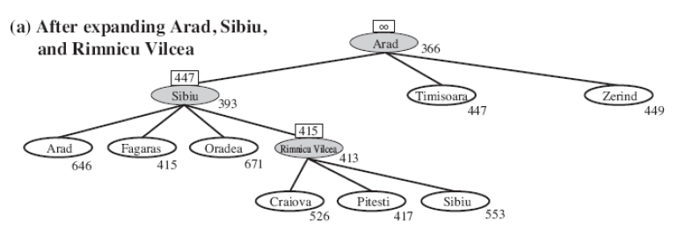
RBFS
f-limit
f-cost
(a) The path via Rimnicu Vilcea is followed until the current best leaf (Pitesti) has a value that is worse than the best alternative path (Fagaras).

Slide 20
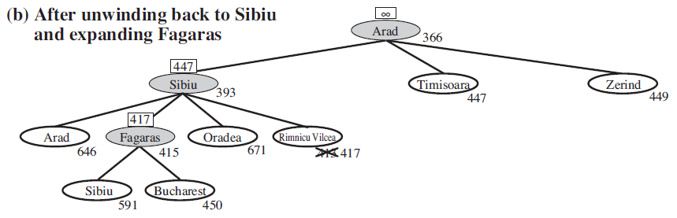
RBFS
(b) The recursion unwinds and the best leaf value of the forgotten subtree (417) is backed up to Rimnicu Vilcea;
then Fagaras is expanded, revealing a best leaf value of 450.

Slide 21
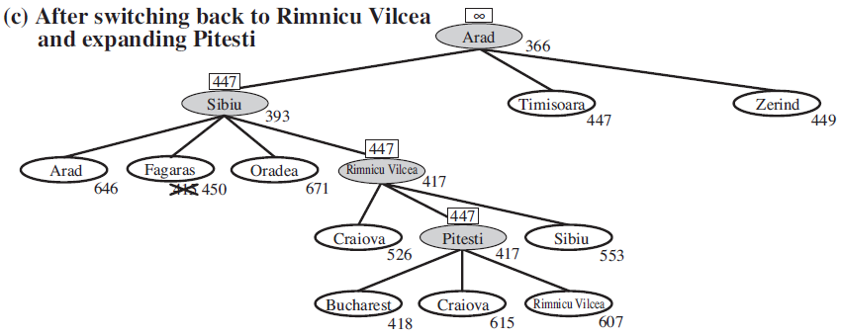
RBFS
(c) The recursion unwinds and the best leaf value of the forgotten subtree (450) is backed up to Fagaras; then Rimnicu Vilcea is expanded. This time, because the best alternative path (through Timisoara) costs at least 447, the expansion continues to Bucharest.

Slide 22
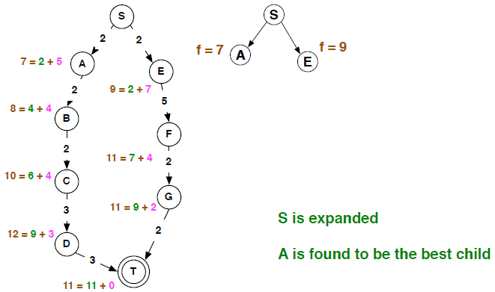
RBFS – 1

Slide 23
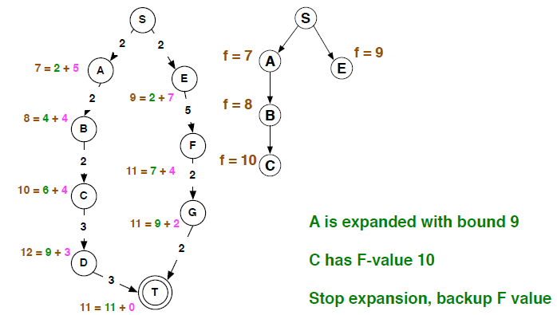
RBFS – 2

Slide 24
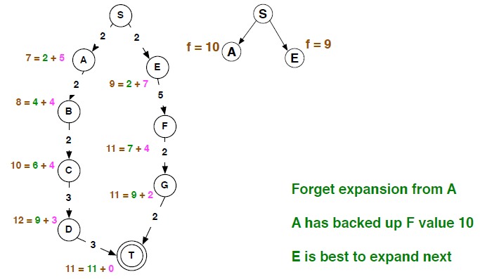
RBFS – 3

Slide 25
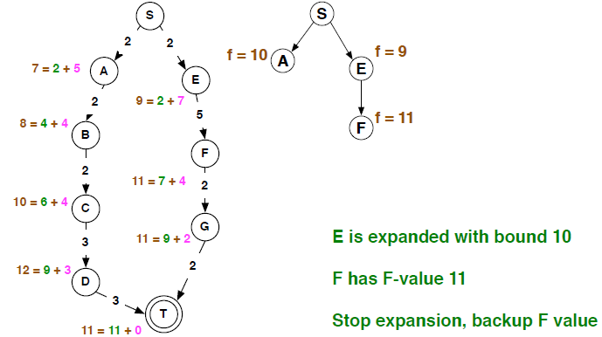
RBFS – 4

Slide 26
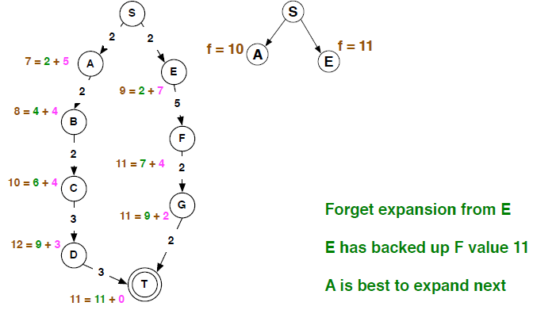
RBFS – 5

Slide 27
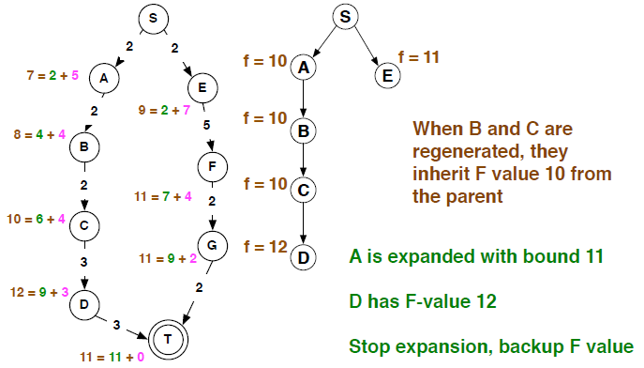
RBFS – 6

Slide 28
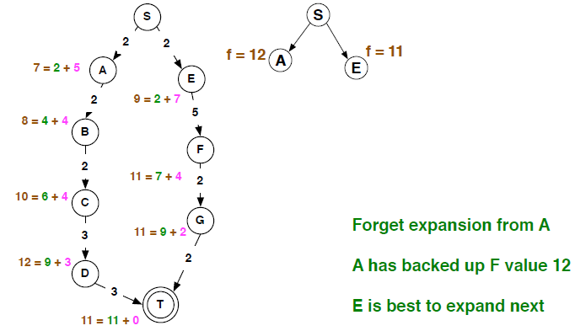
RBFS – 7

Slide 29
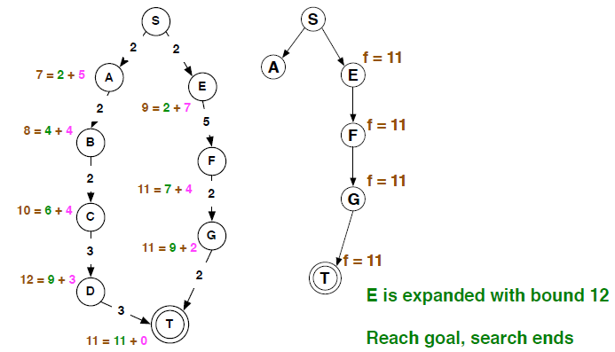
RBFS – 8

Slide 30
RBFS
still suffers from excessive node regeneration.
Optimal
Its space complexity is linear in the depth of the deepest optimal solution,
Its time complexity is rather difficult to characterize: depends on the accuracy of the heuristic function and how the best path changes as nodes are expanded.

Slide 31
RBFS – Properties
RBFS is an optimal algorithm if the heuristic function h(n) is admissible.
Its space complexity is linear in the depth of the deepest optimal solution.
Its time complexity is rather difficult to characterize: it depends both on the accuracy of the heuristic function and on how often the best path changes as nodes are expanded.
RBFS suffer from using too little memory.
Because they forget most of what they have done, both algorithms may end up re-expanding the same states many times over.
It suffer the potentially exponential increase in complexity associated with redundant paths in graphs

Slide 32
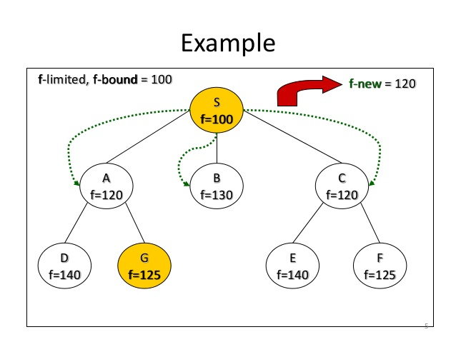
IDA*

Slide 33
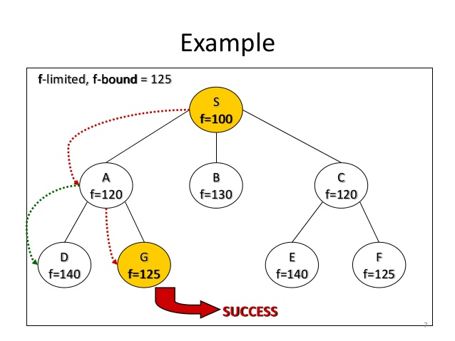
IDA*

Slide 35
f_bound = 0
f_new = 7
S(7)

Slide 36
f_bound = 7
f_new = 10
S(7)
A(11)
B(10)

Slide 37
f_bound = 10
f_new = 11
S(7)
A(11)
B(10)
C(12)
G(13)

Slide 38
f_bound = 11
f_new =
S(7)
A(11)
B(10)
C(12)
G(13)
C(12)
G(13)

